Slide 1
COMP5523 Lab 2
Segmentation

Slide 2
Outline
Recap on clustering
Lab details
Administrative details

Slide 3
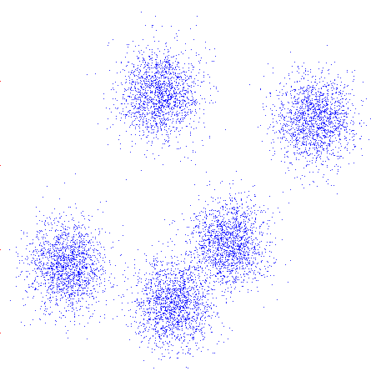
K-Means
An iterative clustering algorithm
Pick K random points as cluster centers (means)
Alternate:
Assign data instances to closest mean
Assign each mean to the average of its assigned points
Stop when no points’ assignments change

Slide 4
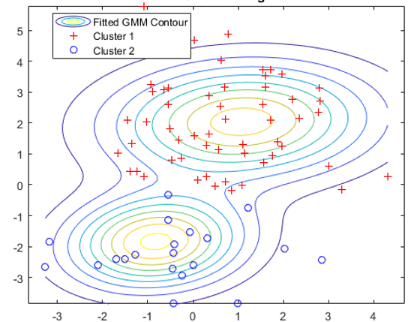
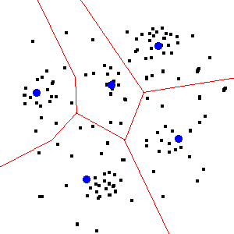

K-means can be regarded as a variant of Gaussian Mixture Model
Hard assignment
$σ fixed$
Bishop PRML chapter 9~11

Slide 5


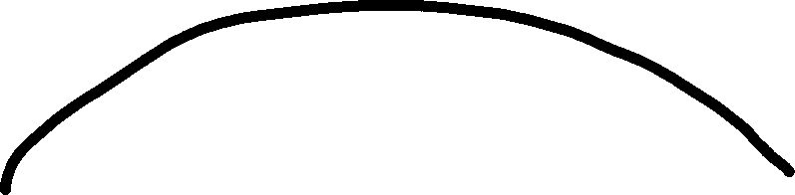
EM in nutshell
Jensen's inequality if you’re interested

Slide 6
Outline
Recap on clustering
Lab details
Administrative details

Slide 7
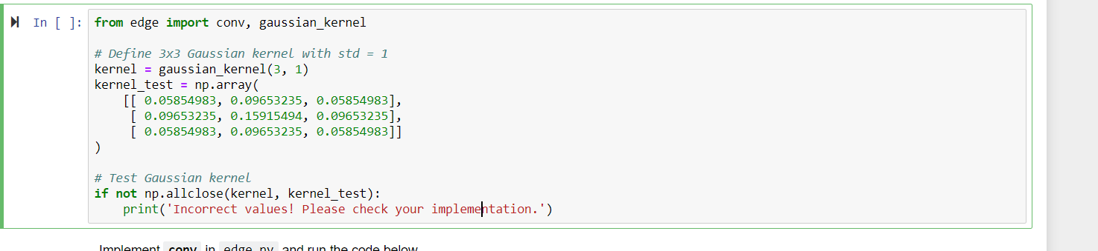
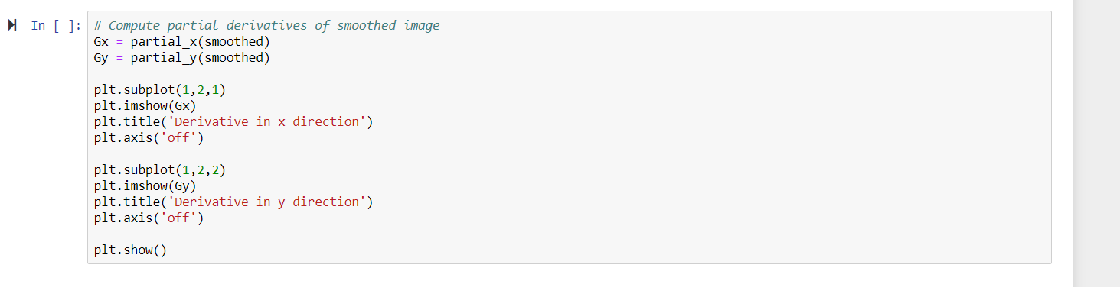
What your can change in lab material?

Slide 8
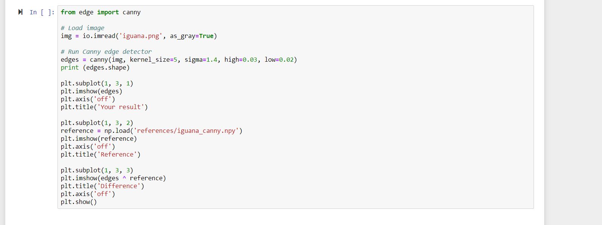

Arguments are part of your algorithms!

Slide 9
Why k-means?
Basics empower your further careers.

Slide 10
Outline
Recap on clustering
Lab details
Administrative details

Slide 11
Share your ideas and efforts by adding more comments in your codes.
If you want to share more, pls give us a pdf report.

Slide 12
Due: April 19 at 23:59 pm

